Slide 1
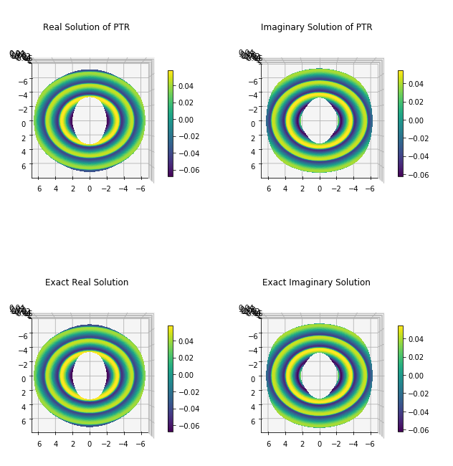
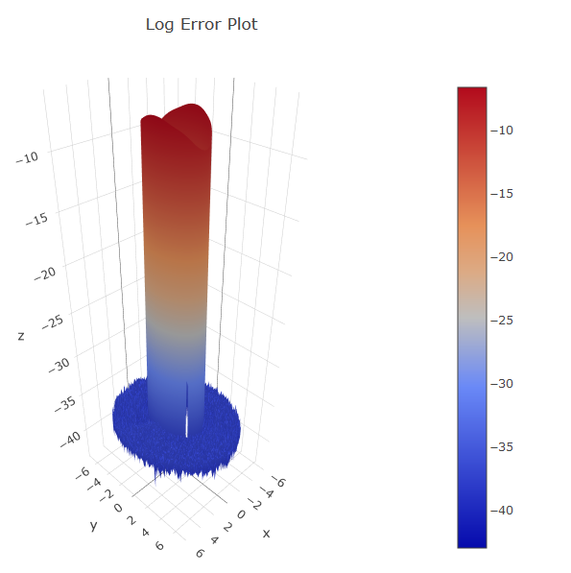
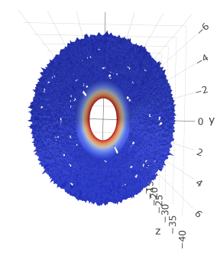
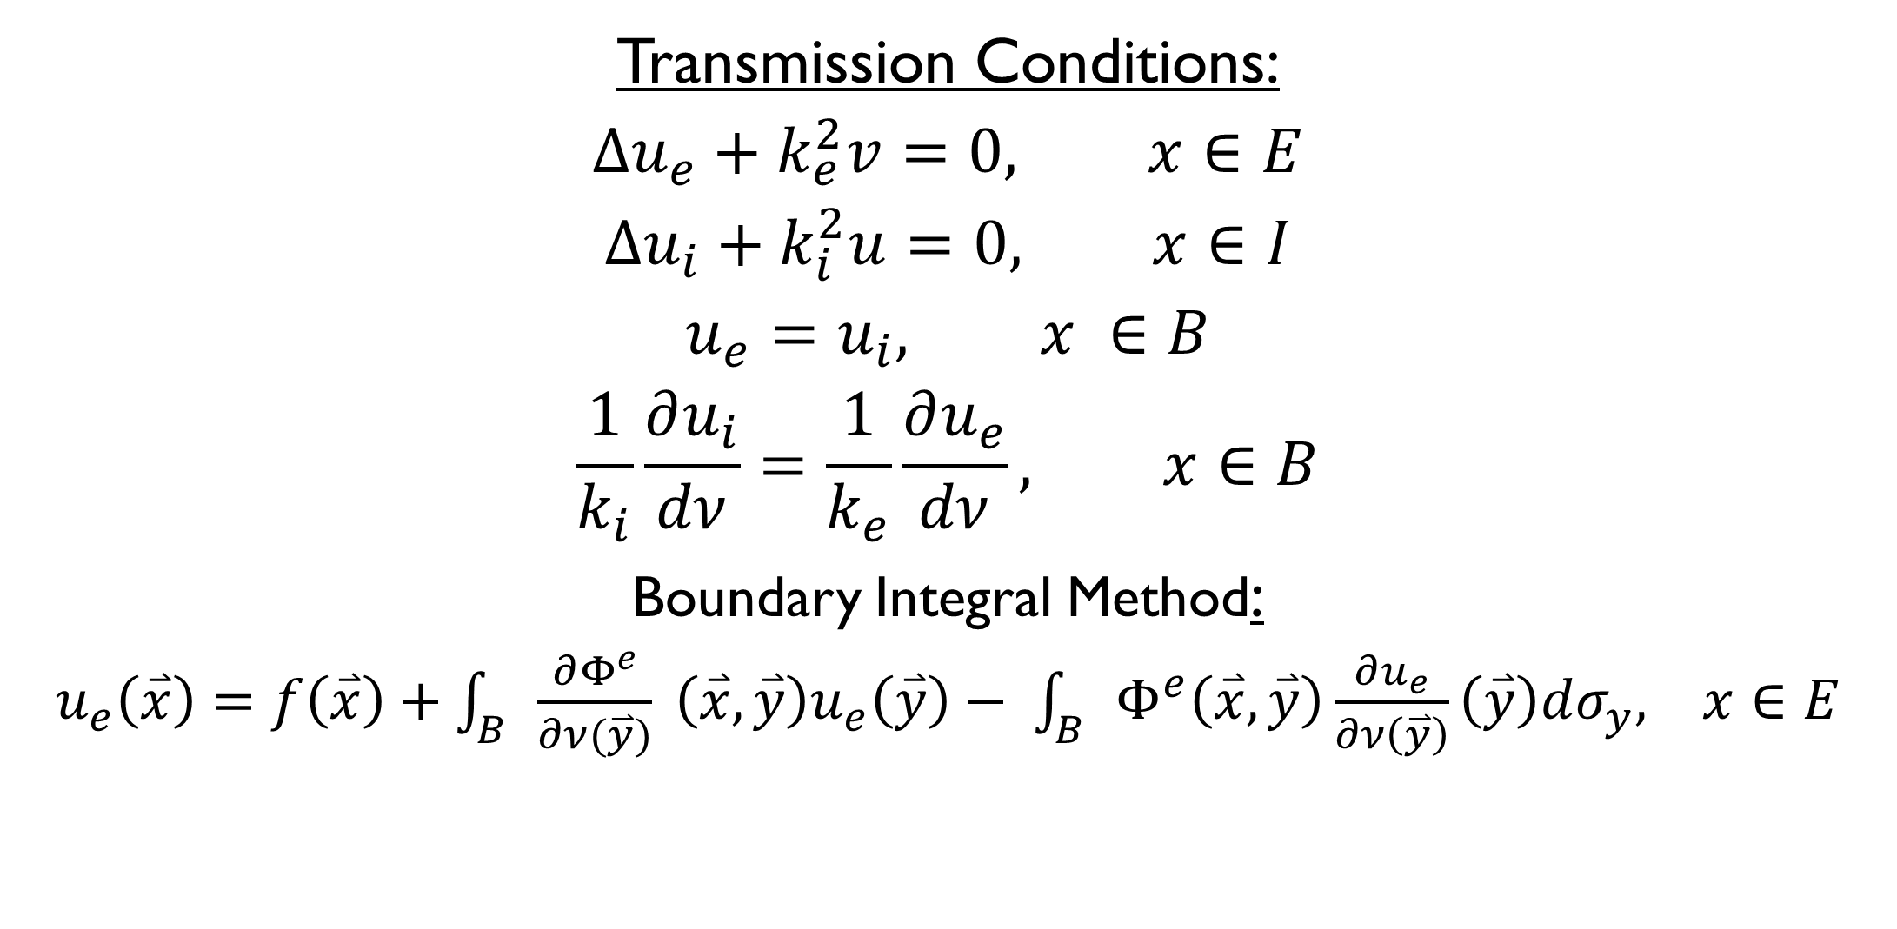
Cloaking using Periodic Trapezoid Rule Approximation of Boundary Integrals
Elsie A. Cortes, Camille Carvalho, PhD, School of Natural Sciences, University of California, Merced
Project Problem
Numerical Method
Transmission
Our goal is to simulate optical cloaking devices by calculating the transversal of particles through a boundary. Optical cloaking is…. Because a cloaked object scatters particles more than an uncloaked object, we use a layered boundary to direct their incidence waves around the cloaked object. The periodic trapezoid rule is used to approximate the propagation of these waves.
Acoustic Scattering
Transmission Problem
Conclusion
Transmission Conditions:
$$∆u_{e}+k_{e}^{2}v=0, x∈E$$
$$∆u_{i}+k_{i}^{2}u=0, x∈I$$
$$u_{e}=u_{i}, x ∈B$$
$$\frac{1}{k_{i}}\frac{∂u_{i}}{dν}=\frac{1}{k_{e}}\frac{∂u_{e}}{dν}, x∈B$$
Boundary Integral Method:
$u_{e}\left(\overset{⃑}{x}\right)=f\left(\overset{⃑}{x}\right)+\int_{B}{\frac{∂Φ^{e}}{∂ν(\overset{⃑}{y})}} \left(\overset{⃑}{x}, \overset{⃑}{y}\right)u_{e}\left(\overset{⃑}{y}\right)− \int_{B}{Φ^{e}\left(\overset{⃑}{x}, \overset{⃑}{y}\right)\frac{∂u_{e}}{∂ν\left(\overset{⃑}{y}\right)}\left(\overset{⃑}{y}\right)dσ_{y}, x∈E}$

